Slide 1


FIT9136 PASS WEEK 11
Introduction to Recursion
7th Oct 2024
CL_33 Innovation Walk, Room C107 / Online

Slide 2

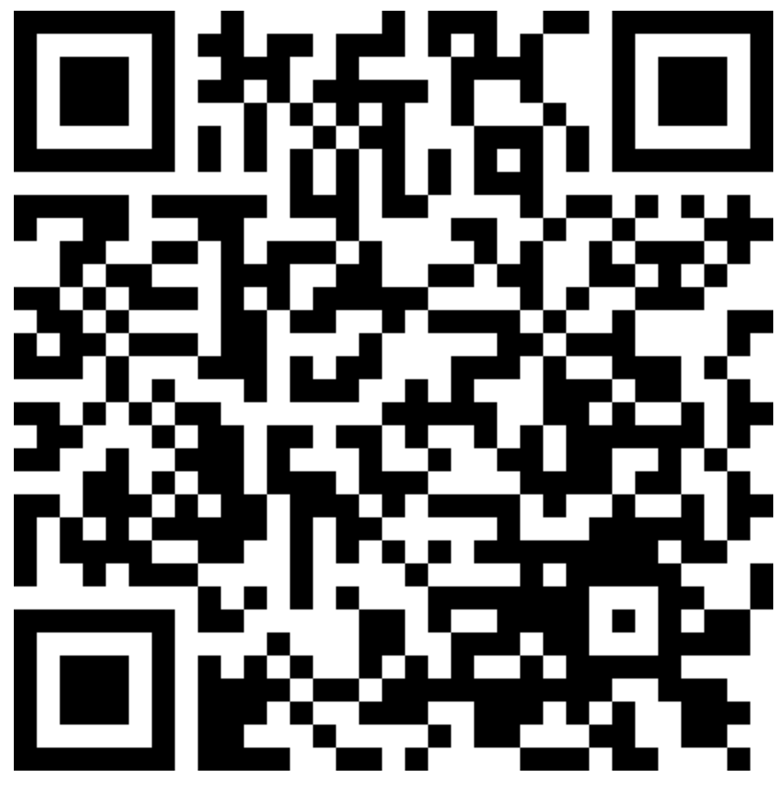
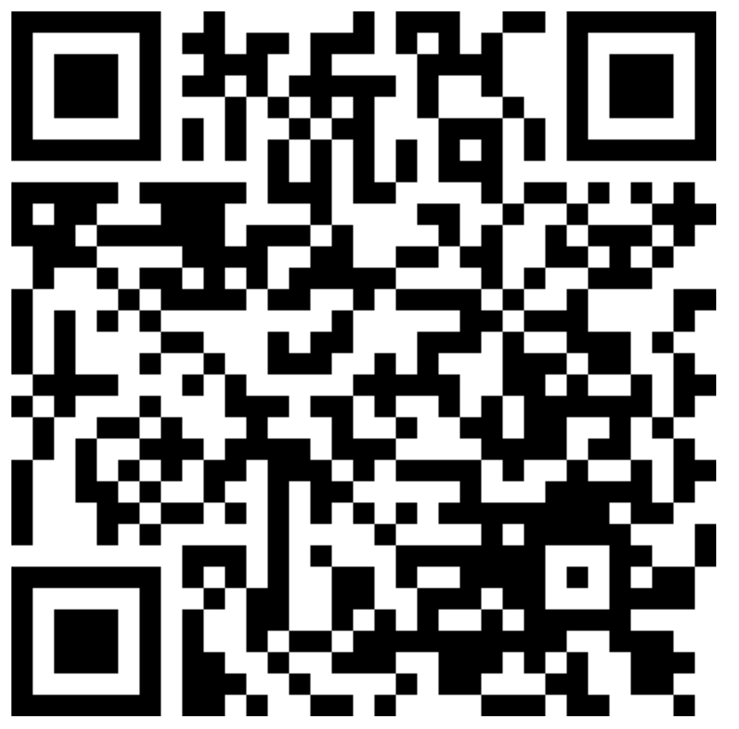
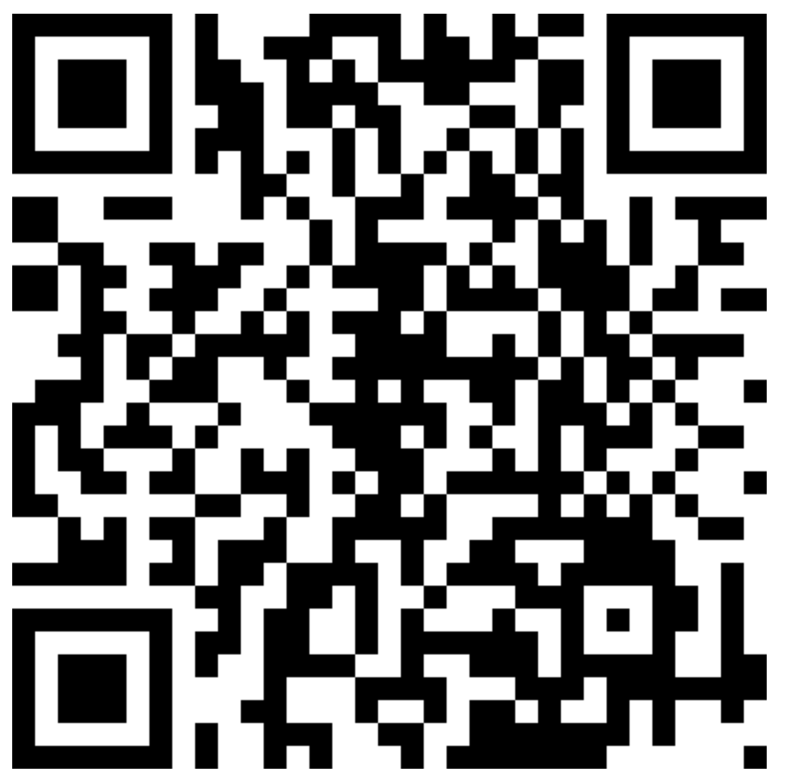

Attendance & Resources
Any questions? Email me: harry.wang1@monash.edu
Also find the drive to receive the weekly slides: https://tinyurl.com/FIT9136-PASS
Want to have GitHub Repo to access them? GitHub: https://github.com/chiefhaowang/PASS-Weekly
SSH: git@github.com:chiefhaowang/PASS-Weekly.git
HTTPS: https://github.com/chiefhaowang/PASS-Weekly.git
Monday 2-3pm
Tuesday 9-10am
Tuesday 4-5pm

Slide 3
Agenda
01
What is Recursion - 30 mins
Concept recap
02
Practice - 15 mins
03
Closure speaking - 10 mins
Conclusion + Q&A + Attendance recording

Slide 4
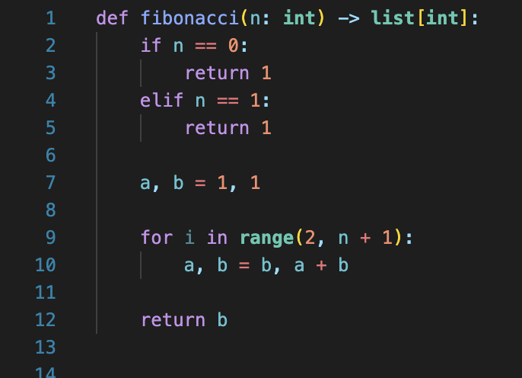
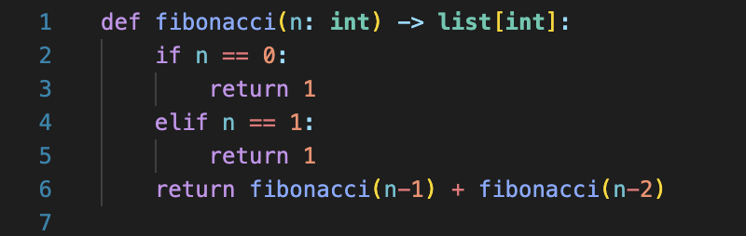
Recursion is …
Recursion is a method of solving problems that involves breaking a problem down into smaller and smaller subproblems until you get to a small enough problem that it can be solved trivially. Recursion involves a function calling itself. While it may not seem like much on the surface, recursion allows us to write elegant solutions to problems that may otherwise be very difficult to program.

Slide 5
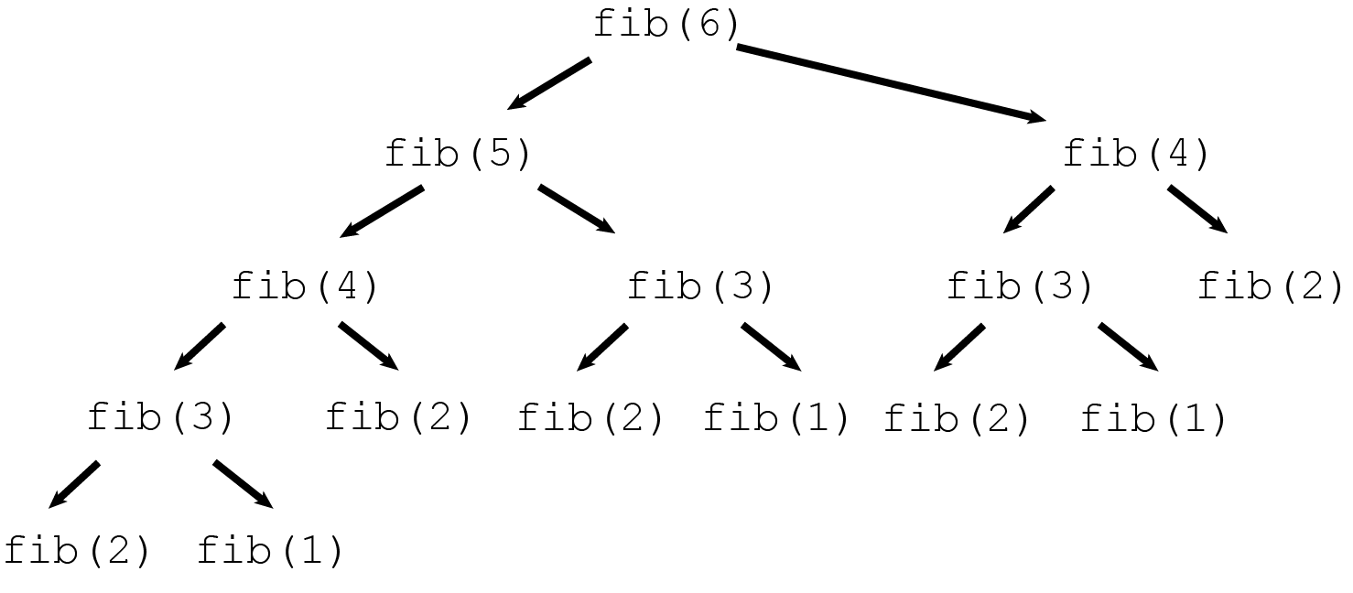
Recursion is …
Problem will be broken into smaller pieces
Bigger piece returns the value depends on what the smaller piece returned

Slide 6
Recursion is …
Three laws to make it a recursion coding method
Base case
Keep moving toward the base case
Function calling itself

Slide 7
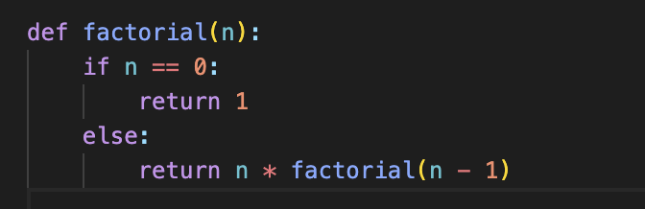
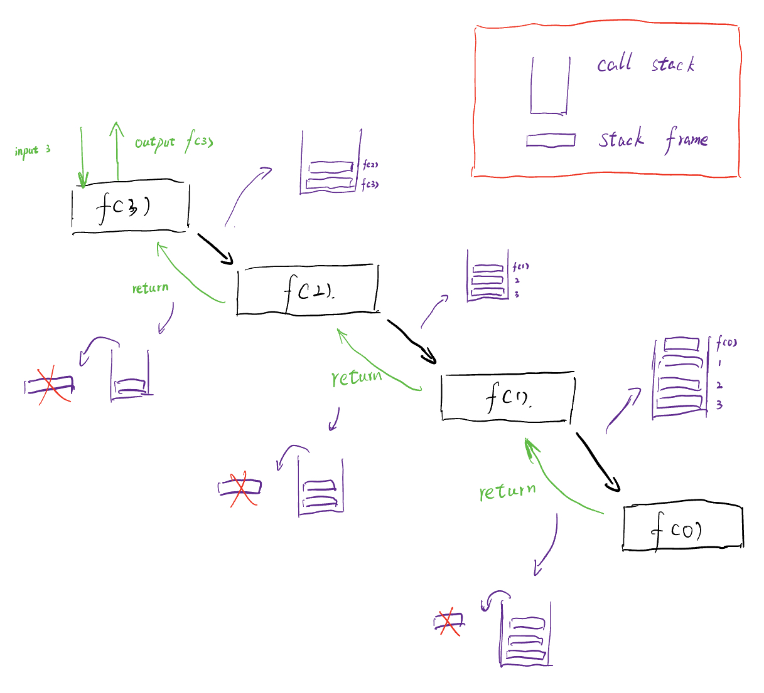
Recursion is … (physically)
Initially, the stack contains:
• factorial(3) → Calls factorial(2)
After the first recursive call:
• factorial(3)
• factorial(2) → Calls factorial(1)
After the second recursive call:
• factorial(3)
• factorial(2)
• factorial(1) → Calls factorial(0)
After reaching the base case:
• factorial(0) returns 1
• factorial(1) returns 1 * 1 = 1
• factorial(2) returns 2 * 1 = 2
• factorial(3) returns 3 * 2 = 6

Slide 8
Example 1: Fibonacci
By definition, the first two numbers of a Fibonacci sequence would be 1 and 1, and each of the subsequent numbers is the sum of the previous two numbers.
Regularity

Slide 9
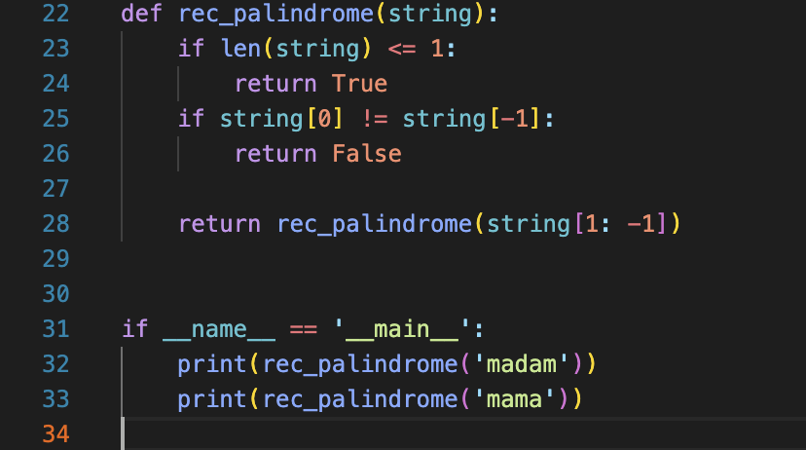
Example 2: Computing palindromes
Write a recursive function rec_palindrome(string) that checks whether the input string is a palindrome string (i.e., return True) or not (i.e., return False). A palindrome string is a string that reads the same from either direction.

Slide 10
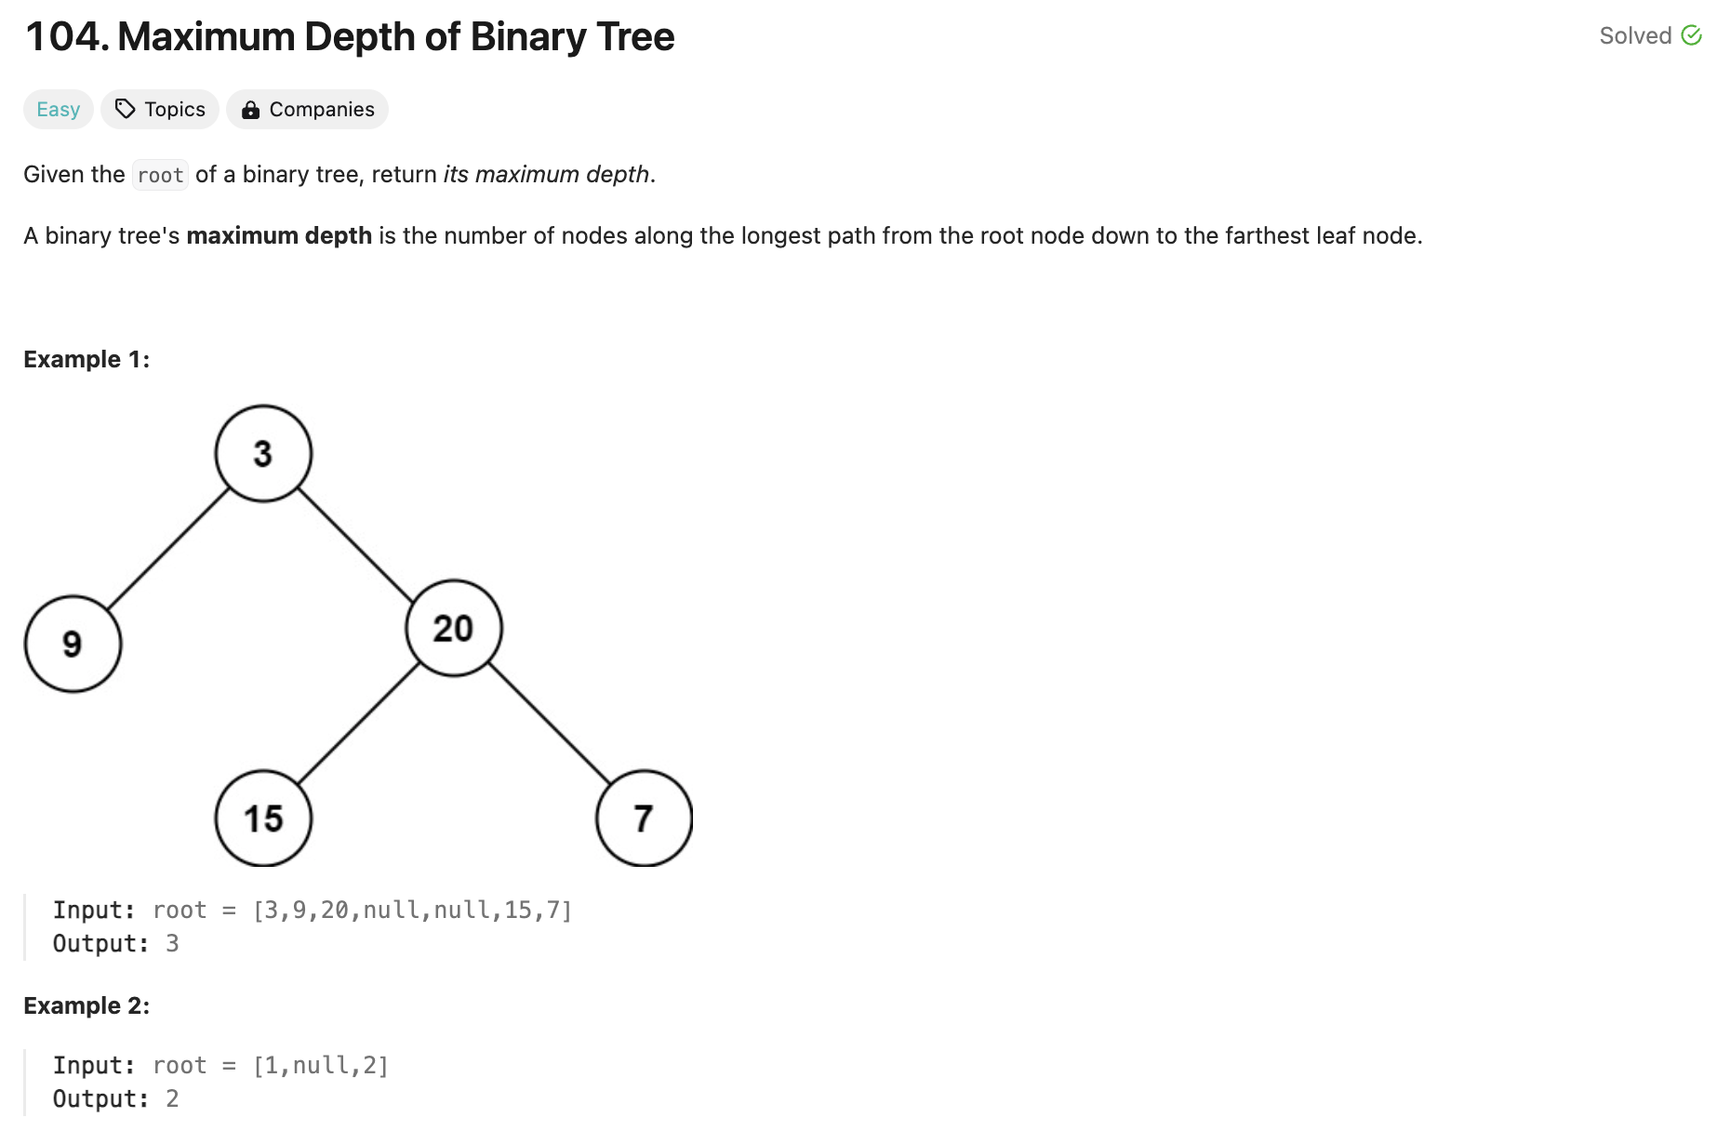
Practice
Leetcode:
https://tinyurl.com/wk11-practice
Solution: https://tinyurl.com/FIT9136-PASS/week11/solution/binary_tree_depth.py

Slide 11
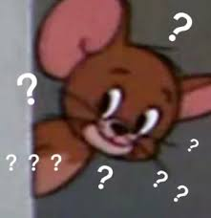
Let’s see what we got today
What is recursion, and why people use recursion?
How to explain recursion in both logical and physical way?
Could you use recursion now?

Slide 12
Attendance & Resources
Any questions? Email me: harry.wang1@monash.edu
Also find the drive to receive the weekly slides: https://tinyurl.com/FIT9136-PASS
Want to have GitHub Repo to access them? GitHub: https://github.com/chiefhaowang/PASS-Weekly
SSH: git@github.com:chiefhaowang/PASS-Weekly.git
HTTPS: https://github.com/chiefhaowang/PASS-Weekly.git
Monday 2-3pm
Tuesday 9-10am
Tuesday 4-5pm

Slide 13
Thank You
7th Oct 2024
CL_33 Innovation Walk, Room C107 / Online

Slide 14
Questions & Answers
7th Oct 2024
CL_33 Innovation Walk, Room C107 / Online

